Slide 1



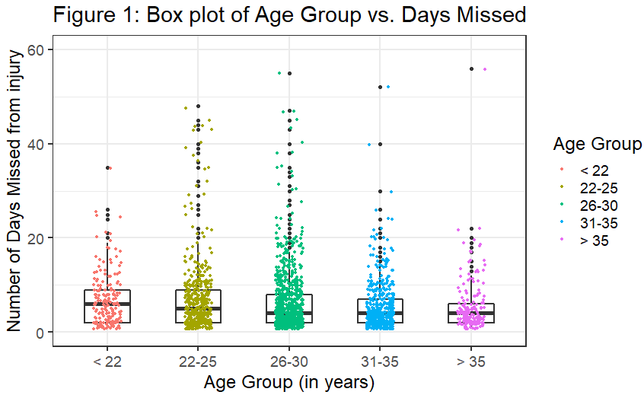
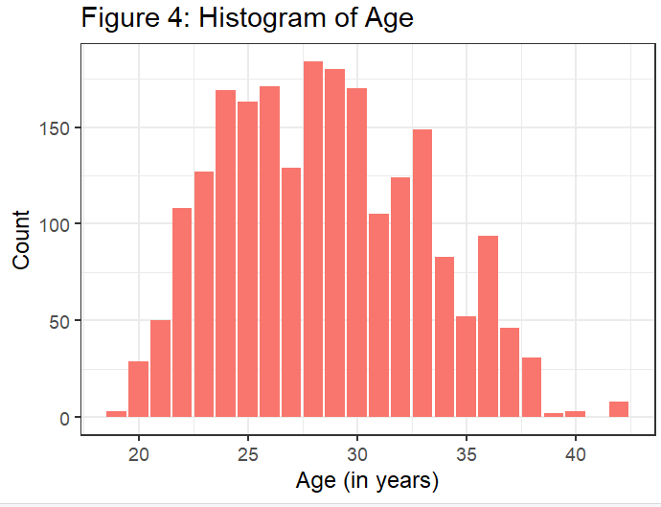
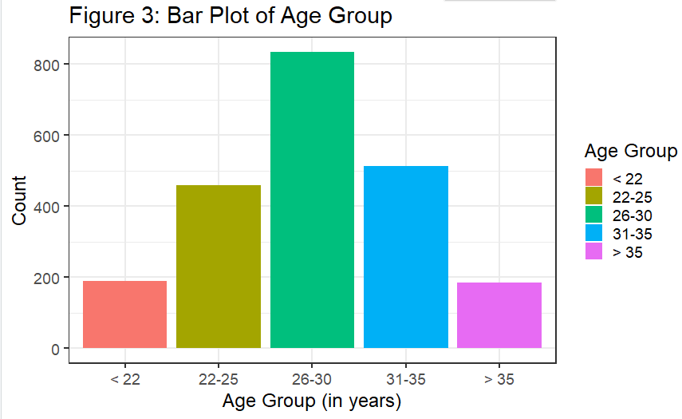
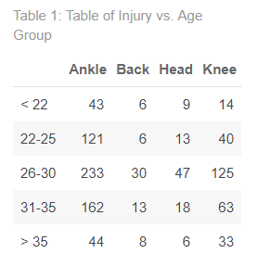
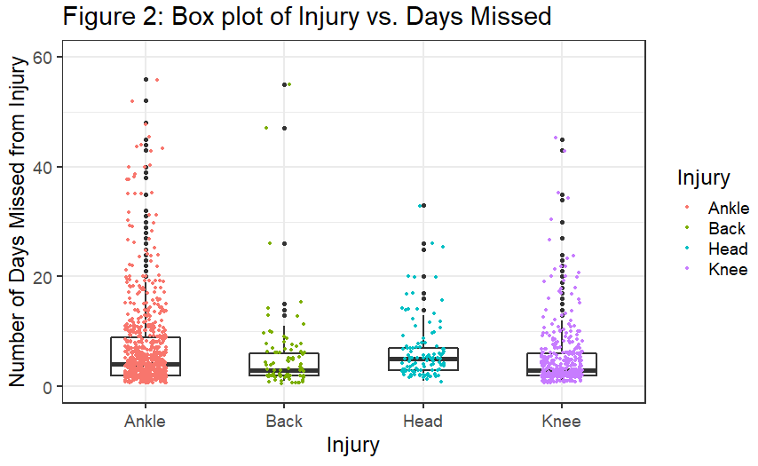
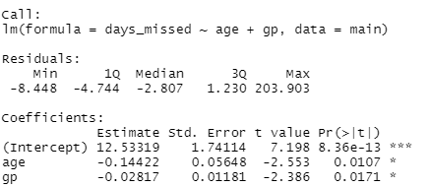


NBA Player Injuries Analysis
Lauren Cohen
INTRODUCTION
Michael Frankel, Shelby Taylor
CONCLUSION
Are there factors to predict how long NBA players will miss games due to injury? This project will be more of a descriptive study to show how factors such as age, types of injury and number of games played for NBA players will affect how many days they miss upon getting injured. The data comes from Hashtag basketball and NBA.com player profiles from time frames of 2017-2022. Manipulating and discretizing data was needed in this process to make age group and type of injury variable that were appropriate and showed significance.
The beginning of this project was very insignificant with hypotheses researched. After adding more players to the dataset and focusing on specific variables there were more conclusive results. The main variables that showed significance were the age of the player and location of where the injuries occurred.
At the 0.05 alpha level there is a significant difference in the mean of days missed based on where the location of the injury is. Also, at the 0.05 alpha level the probability of the type of injury a player receives is affected by the age (group) of the player. At the 0.10 alpha level, we can use age as a predictor for how many days a player will miss from an injury.
In conclusion, this research is a bit to predict injury patterns in NBA players. In the future, factors that would be interesting to explore are the number of minutes played for each player and looking into the recurring injuries of the players.
METHODS
Linear Regression and Box Plot Graph to show that the older players are more likely to miss more days while being injured
Chi Square Test to show that the probability of the type of injury a player receives is affected by the age (group) of the player
Anova Test to show that the type of injury for the player affects how many days are missed by the player.
R CODE
results <-lm(main_stats$days_missed~main_stats$age)
summary(results)
anova(results)
results_injury <-aov(data=main, days_missed ~ injury)
summary(results_injury)
main %>%
filter(injury != 'Covid') %>%
ggplot(aes(x=injury, y=days_missed)) +
geom_boxplot(width=0.5,lwd=1.0) +
theme_bw() +
geom_jitter(width=0.15,size=0.8, aes(color=injury)) +
scale_y_continuous(limits = c(0,60)) +
labs(title= "Figure 2: Box plot of Injury vs. Days Missed", x="Injury",
y= "Number of Days Missed from Injury", colour = 'Injury')
Table <- table(age_df1$age_group, age_df1$injury)
table %>%
kbl(caption = "Table 1: Table of Injury vs. Age Group") %>%
kable_paper("striped", full_width = F) %>%
kable_styling()
chisq.test(age_df1$age_group, age_df1$injury, correct=FALSE)
results_both <- lm(days_missed ~ age + gp , data=main)
summary(results_both)
RESULTS
Looking at Figure 1, the box plot suggests age group of players less than 22 years old on average miss more days than any other age group. When running the linear regression for age predicting days missed of a player: As the age of the players increases by 1 year, the average number of days missed decreases by 0.10285 days; the p-value is 0.0998.
Looking at Figure 2, Head injuries show the highest mean of days missed despite having the lowest number of observations in this category. The Anova Test showed the location of the injury on the body and how many days are missed with the p-value of 0.00137.
Looking at Table 1, we can see the largest group is ankle injuries in the age group of 26-30 years old with 233 observations. The chi-square test on variables of age group and type of injury produced the p-value of 0.02379.
Lastly, running a multiple linear regression, to predict number of days missed based on age of player and the number of games they played showed that they are both significant variables to predict. The interesting thing is as both age and games played increased, the number of games missed decreases by relatively small amounts.

